Slide 1

CS 360 Programming Languages Interpreters

Slide 2
Implementing PLs
Most of the course is learning fundamental concepts for using and understanding PLs.
Syntax vs. semantics vs. idioms.
Powerful constructs like closures, first-class objects, iterators (streams), multithreading, …
An educated computer scientist should also know some things about implementing PLs.
Implementing something requires fully understanding its semantics.
Things like closures and objects are not “magic.”
Many programming tasks are like implementing small PLs.
Example: "connect-the-dots programming language" from 141.

Slide 3
Ways to implement a language
Two fundamental ways to implement a programming language X.
Write an interpreter in another language Y.
Better names: evaluator, executor.
Immediately executes the input program as it's read.
Write a compiler in another language Y that compiles to a third language Z.
Better name: translator
Takes a program in X and produce an equivalent program in Z.

Slide 4
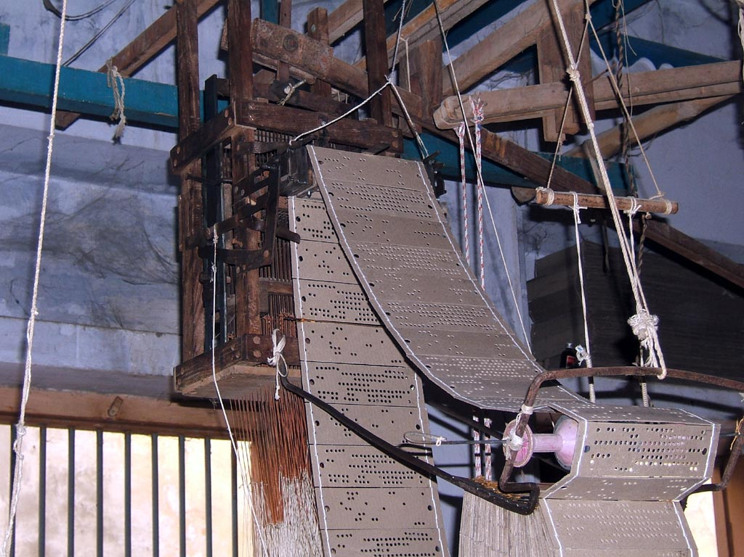
First programming language?
Notes:
Jacquard loom invented by joseph marie jacquard in 1801 that weaves textiles based on patterns in punched cards.

Slide 5
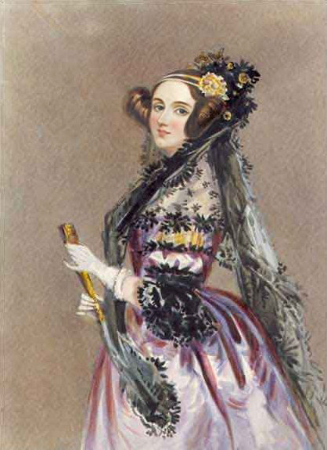
First programming language?
Notes:
In 1842-43, Ada Lovelace was translating a memoir in Italian about Charles Babbage with whom she worked on a theoretical computer called the analytical engine, the first general purpose computer. She included a program to calculate Bernoulli numbers, and because of this, she is regarded as the first computer programmer. Worth noting that although Babbage designed the machine, he never saw it built because he lacked the funding and had some disagreements with his engineer.

Slide 6
Interpreters vs compilers
Interpreters
Takes one "statement" of code at a time and executes it in the language of the interpreter.
Like having a human interpreter with you in a foreign country.
Compilers
Translate code in language X into code in language Z and save it for later. (Typically to a file on disk.)
Like having a person translate a document into a foreign language for you.

Slide 7
Reality is more complicated
Evaluation (interpreter) and translation (compiler) are your options.
But in modern practice we can have multiple layers of both.
A example with Java:
Java was designed to be platform independent.
Any program written in Java should be able to run on any computer.
Achieved with the "Java Virtual Machine."
An idealized computer for which people have written interpreters that run on "real" computers.

Slide 8
Example: Java
Java programs are compiled to an "intermediate representation" called bytecode.
Think of bytecode as an instruction set for the JVM.
Bytecode is then interpreted by a (software) interpreter in machine-code.
Complication: Bytecode interpreter can compile frequently-used functions to machine code if it desires (just-in-time compilation).
CPU itself is an interpreter for machine code.

Slide 9
Sermon
Interpreter vs compiler vs combinations is about a particular language implementation, not the language definition.
So there is no such thing as a “compiled language” or an “interpreted language.”
Programs cannot “see” how the implementation works.
Unfortunately, you hear these phrases all the time:
“C is faster because it’s compiled and LISP is interpreted.”
I can write a C interpreter or a LISP compiler, regardless of what most implementations happen to do.

Slide 10
One complication
In a traditional implementation via compiler, you do not need the language implementation (the compiler) to run the program.
Only to compile it.
To let other people run your program, you give them the compiled binary code.
But Racket, Scheme, LISP, Javascript, Ruby, … have eval
Allows a program, while it is running, to create a string (or in Racket, a list) with arbitrary code and execute it.
Since we don’t know ahead of time what the code will be, we need a language implementation at run-time to support eval
Usually you see this in languages that are traditionally interpreted, because then implementing eval is easy: the interpreter is already available.

Slide 11
eval / apply
These functions are built into Racket, and are a traditional part of LISP/Scheme implementations.
eval: takes a list argument and treats it like program code, executing it and returning the result.
apply: takes a function and a list, and calls the function on the arguments in the list.
Notes:
show in dr racket

Slide 12
quote
Also built-in, but we don't notice it because it's called automatically whenever we use a single quote.
(quote …) or '(…) is a special form that makes “everything underneath” into plain symbols and lists, instead of interpreting them as variables or function calls.
eval and quote are inverses:
quote stops evaluation of something.
eval forces evaluation of something.

Slide 13
Further digression: quoting
Quoting (quote …) or '(…) is a special form that makes “everything underneath” symbols and lists, not variables and calls
But then calling eval on it looks up symbols as code
So quote and eval are inverses
(list 'begin
(list 'print "hi")
(list '+ 4 2))
(quote (begin
(print "hi")
(+ 4 2)))
Notes:
racket data = racket code

Slide 14
Back to implementing a language
"(cons 1 '(2 3))"
Possible
Errors /
warnings
Parsing
Call
Function
Integer
List
cons
Constant
Constant
Constant
1
2
3
Static checking
(what is checked
depends on PL)
Possible
Errors /
warnings
Rest of
implementation

Slide 15
Skipping those steps
LISP/Scheme-like languages have an interesting property:
The format in which we write the program code (a list) is identical to the main data structure the language itself uses to represent data (a list).
Because these lists are always fully parenthesized, we get parsing essentially for free!
Not so in Python, C++, Java, etc.
We can also, for simplicity, skip static checking.
Assume subexpressions have correct types.
We will not worry about (add #f "hi").
Interpreter will just crash.

Slide 16
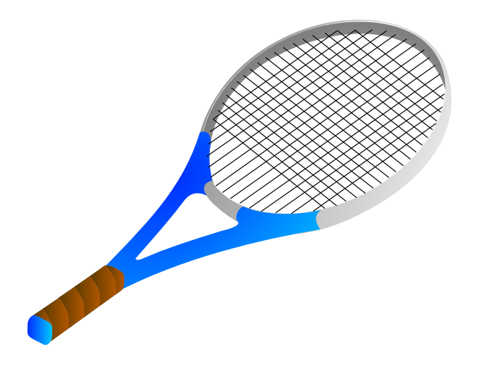
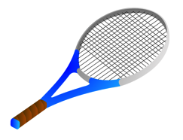
Write (Mini-)Racket in Racket
Notes:
We're going to write a subset of racket that only will evaluate mathematical expressions, nothing with lists or pairs or any other data structure. Called MINI RACKET.

Slide 17
Mini-Racket
Only one data type: numbers.
No booleans, lists, etc.
Mini-Racket will use names for all functions rather than symbols.
add, sub, mul, etc.
Simplified mechanisms for conditionals, function definitions, and function calls.

Slide 18
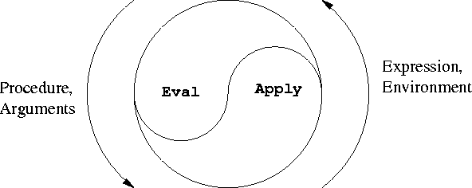
Heart of the interpreter
mini-eval: Evaluates an expression and returns a value (will call mini-apply to handle functions)
mini-apply: Takes a function and argument values and evaluate its body (calls mini-eval).
Notes:
Note how these are mutually recursive.

Slide 19
(define (mini-eval expr env)
is this a ______ expression?
if so, then call our special handler
for that type of expression.
)
What kind of expressions will we have?
numbers
variables (symbols)
math function calls
others as we need them

Slide 20
How do we evaluate a (literal) number?
That is, when the interpreter sees a number, what value should it return?
Just return it!
Psuedocode for first line of mini-eval:
If this expression is a number, then return it.

Slide 21
How do we handle (add 3 4)?
Need two functions:
One to detect that an expression is an addition expression.
One to evaluate the expression.

Slide 22
(add 3 4)
Is this an expression an addition expression?
(equal? 'add (car expr))
Evaluate an addition expression:
(+ (cadr expr) (caddr expr))

Slide 23
You try (lab, part 1)
Add subtraction (e.g., sub)
Add multiplication (mul)
Add division (div)
Add exponentiation (exp)
Optional:
Add other primitives, like sqrt, abs, etc.
Make sub work with single arguments (returns the negation).

Slide 24
(add 3 (add 4 5))
Why doesn't this work?

Slide 25
(add 3 (add 4 5))
How should our language evaluate this sort of expression?
We could forbid this kind of expression.
Insist things to be added always be numbers.
Or, we could allow the things to be added to be expressions themselves.
Need a recursive call to mini-eval inside eval-add.

Slide 26
You try (lab, part 2)
Fix your math commands so that they will recursively evaluate their arguments.

Slide 27
Adding Variables

Slide 28
Implementing variables
Represent a frame as a hash table.
Racket's hash tables:
(define table (make-hash))
(hash-set! table key value)
(hash-has-key? table key)
(hash-ref table key)

Slide 29
Implementing variables
Represent an environment as a list of frames.
global
x 2
y 3
hash table
x: 7
y: 1
hash table
x: 2
y: 3
f .
x 7
y 1

Slide 30
Implementing variables
Two things we can do with a variable in our programming language:
Define a variable
Get the value of a variable
Pretty much the same two things we can do with a variable in regular Racket (except for set!)

Slide 31
Getting the value of a variable
New type of expression: a symbol.
Whenever mini-eval sees a symbol, it should look up the value of the variable corresponding to that symbol.

Slide 32
Getting the value of a variable
Follow the rules of lexical scoping:
(define (lookup-variable-value var env)
; Pseudocode:
; If our current frame has a value for the
; variable, then get its value and return it.
; Otherwise, if our current frame has a frame
; pointer, then follow it and try the lookup
; there.
; Otherwise, (if we are out of frames), throw an
; error.

Slide 33
Getting the value of a variable
Follow the rules of lexical scoping:
(define (lookup-variable-value var env)
(cond ((hash-has-key? (car env) var)
(hash-ref (car env) var))
((not (null? env))
(lookup-variable-value var (cdr env)))
((null? env)
(error "unbound variable" var))))

Slide 34
Defining a variable (lab, part 3)
mini-eval needs to handle expressions that look like (define variable expr)
expr can contain sub-expressions.
Add two functions to the evaluator:
definition?: tests if an expression fits the form of a definition.
eval-definition: extract the variable, recursively evaluate the expression that holds the value, and add a binding to the current frame.

Slide 35
Implementing conditionals
We will have one conditional in Mini-Racket: ifzero
Syntax: (ifzero expr1 expr2 expr3)
Semantics:
Evaluate expr1, test if it's equal to zero.
If yes, evaluate and return expr2.
If no, evaluate and return expr3.

Slide 36
Implementing conditionals (lab, part 4)
Add functions ifzero? and eval-ifzero.
If time, try challenges on the back of the lab.

Slide 37
Designing our interpreter around mini-eval.
(define (mini-eval expr env) …
Determines what type of expression expr is
Dispatch the evaluation of the expression to the appropriate function
number? -> evaluate in place
symbol? -> lookup-variable-value
add?/subtract?/multiply? -> appropriate math func
definition? -> eval-define
ifzero? -> eval-ifzero

Slide 38
Today
Two more pieces to add:
Closures (lambda? / eval-lambda)
Function calls (call? / eval-call)

Slide 39
Mini-Racket will have some simplifications from normal Racket.
All functions will have exactly one argument.
Removes the need for lambda expressions to have parentheses.
Normal Racket: (lambda (x) (+ x 1))
Mini-Racket: (lambda x (add x 1))

Slide 40
Mini-Racket will have some simplifications from normal Racket.
Normal Racket has two versions of define, one for variables and one for functions: (define x 3) (define (add1 x) (+ x 1)).
The 2nd version is just a shortcut for (define add1 (lambda (x) (+ x 1))

Slide 41
Mini-Racket will have some simplifications from normal Racket.
Mini-Racket will not have the "shortcut" define; we must use an explicit lambda.
Normal Racket: (define (add1 x) (+ x 1)) (define add1 (lambda (x) (+ x 1)))
Mini-Racket: (define add1 (lambda x (add x 1))

Slide 42
Mini-Racket will have some simplifications from normal Racket.
Normal Racket recognizes a function call as any list that starts with a function name (or anything that evaluates to a closure).
Mini-Racket will recognize function calls as lists that starts with the symbol call.
This makes the Mini-Racket syntax more complicated, but simplifies the interpreter code.

Slide 43
Mini-Racket will have some simplifications from normal Racket.
Normal Racket: (add1 5)
Mini-Racket: (call add1 5)

Slide 44
Implementing closures
In Mini-Racket, all (user-defined) functions and closures will have a single argument.
Syntax: (lambda var expr)
Note the different syntax from "real" Racket.
Semantics: Creates a new closure (anonymous function) of the single argument var, whose body is expr.

Slide 45
(lambda var expr)
Need a new data structure to represent a closure.
Why can't we just represent them as the list (lambda var closure) above?
Hint: What is missing? Think of environment diagrams.

Slide 46
(lambda var expr)
We will represent closures internally in Mini-Racket using a list of four components:
The symbol 'closure
The argument variable (var)
The body (expr)
The environment in which this closure was defined.

Slide 47
Evaluate at top level: (lambda x (add x 1))
Our evaluator should return
'(closure x (add x 1) (#hash(…)))
global
Arg: x
Code: (add x 1)

Slide 48
Write lambda? and eval-lambda
lambda? is easy.
eval-lambda should:
Extract the variable name and the body, but don’t evaluate the body (not until we call the function)
Return a list of the symbol 'closure, the variable, the body, and the current environment.

Slide 49
(define (eval-lambda expr env)
(list 'closure
(cadr expr) ; the variable
(caddr expr) ; the body
env))

Slide 50
Evaluating closures
Closures, like numbers, are self-evaluating.
Exactly how they are in Racket.
In our language, evaluating a closure returns the closure.
Uncomment Add a closure? function

Slide 51
Function calls
First we need the other half of the eval/apply paradigm.

Slide 52
Remember from environment diagrams:
To evaluate a function call, make a new frame with the function's arguments bound to their values, then run the body of the function using the new environment for variable lookups.

Slide 53
Mini-Apply
(define (mini-apply closure argval)
Pseudocode:
Make a new frame mapping the closure's argument (i.e., the variable name) to argval.
Make a new environment consisting of the new frame pointing to the closure's environment.
Evaluate the closure's body in the new environment (and return the result).

Slide 54
Mini-Apply
(define (mini-apply closure argval)
(let ((new-frame (make-hash)))
(hash-set! new-frame <arg-name> argval)
(let ((new-env
<construct new environment>))
<eval body of closure in new-env>
)))

Slide 55
Mini-Apply
(define (mini-apply closure argval)
(let ((new-frame (make-hash)))
(hash-set! new-frame (cadr closure) argval)
(let ((new-env
(cons new-frame (cadddr closure))))
(mini-eval (caddr closure) new-env))))

Slide 56
Function calls
Syntax: (call expr1 expr2)
Semantics:
Evaluate expr1 (must evaluate to a closure)
Evaluate expr2 to a value (the argument value)
Apply closure to value (and return result)

Slide 57
You try it
Write call? (easy)
Write eval-call (a little harder)
Evaluate expr1 (must evaluate to a closure)
Evaluate expr2 to a value (the argument value)
Apply closure to value (and return result)
When done, you now have a Turing-complete language!

Slide 58
; expr looks like
; (call expr1 expr2)
(define (eval-call expr env)
(mini-apply
<eval the function>
<eval the argument>)

Slide 59
; expr looks like
; (call expr1 expr2)
(define (eval-call expr env)
(mini-apply
(mini-eval (cadr expr) env)
(mini-eval (caddr expr) env)))

Slide 60
The arith-exp example
This embedding approach is exactly what we did for the PL of arithmetic expressions:
Note: So simple there are no dynamic type errors in the interpreter
(struct const (i) #:transparent)
(struct add (e1 e2) #:transparent)
(struct negate (e) #:transparent)
(add (const 4)
(negate (add (const 1)
(negate (const 7)))))
(define (eval-exp e) … )

Slide 61
The interpreter
An interpreter takes programs in the language and produces values (answers) in the language
Typically via recursive helper functions with cases
This example is so simple we don’t need a helper and can assume all recursive results are constants
(define (eval-exp e)
(cond
[(const? e) e]
[(add? e)
(const (+ (const-i (eval-exp (add-e1 e)))
(const-i (eval-exp (add-e2 e)))))]
[(negate? e)
(const (- (const-i (eval-exp (negate-e e)))))]
[#t (error “eval-exp expected an expression”)]))

Slide 62
“Macros”
Another advantage of the embedding approach is we can use the metalanguage to define helper functions that create programs in our language
They generate the (abstract) syntax
Result can then be put in a larger program or evaluated
This is a lot like a macro, using the metalanguage as our macro system
Example:
All this does is create a program that has four constant expressions:
(define (triple x) (add x (add x x)))
(define p (add (const 1) (triple (const 2))))

Slide 63
What’s missing
Two very interesting features missing from our arithmetic-expression language:
Local variables
Higher-order functions with lexical scope
How to support local variables:
Interpreter helper function(s) need to take an environment
As we have said since lecture 1, the environment maps variable names to values
A Racket association list works well enough
Evaluate a variable expression by looking up the name
A let-body is evaluated in a larger environment

Slide 64
Magic in higher-order functions
The “magic”: How is the “right environment” around for lexical scope when functions may return other functions, store them in data structures, etc.?
Lack of magic: The interpreter uses a closure data structure to keep the environment it will need to use later

Slide 65
Function calls
Evaluate 1st subexpression to a closure with current environment
Evaluate 2nd subexpression to a value with current environment
Evaluate closure’s function’s body in the closure’s environment, extended to map the function’s argument-name to the argument-value
And for recursion, function’s name to the whole closure
This is the same semantics we learned a few weeks ago “coded up”
Given a closure, the code part is only ever evaluated using the environment part (extended), not the environment at the call-site

Slide 66
Is this expensive?
Time to build a closure is tiny: make a list with four items.
Space to store closures might be large if environment is large.

Slide 67
Free variables examples
(lambda () (+ x y z))
(lambda (x) (+ x y z))
(lambda (x) (if x y z))
(lambda (x) (let ([y 0]) (+ x y z)))
(lambda (x y z) (+ x y z))
(lambda (x) (+ y (let ([y z]) (+ y y))))

Slide 68
Free variables examples
(lambda () (+ x y z)) ; x y z
(lambda (x) (+ x y z)) ; y z
(lambda (x) (if x y z)) ; y z
(lambda (x) (let ([y 0]) (+ x y z))) ; z
(lambda (x y z) (+ x y z)) ; {}
(lambda (x) (+ y (let ([y z]) (+ y y)))) ; y z

Slide 69
Compiling higher-order functions
Key to the interpreter approach: Interpreter helper function takes an environment argument
Recursive calls can use a different environment
Can also compile higher-order functions by having the translation produce “regular” functions (like in C or assembly) that all take an extra explicit argument called “environment”
And compiler replaces all uses of free variables with code that looks up the variable using the environment argument
Can make these fast operations with some tricks
Running program still creates closures and every function call passes the closure’s environment to the closure’s code

Slide 70
Interpreter steps
Parser
Takes code and produces an intermediate representation (IR), e.g., abstract syntax tree.
Static checking
Typically includes syntactical analysis and type checking.
Interpreter directly runs code in the IR.

Slide 71
Compiler steps
Parser
Static checking
Code optimizer
Take AST and alter it to make the code execute faster.
Code generator
Produce code in output language (and save it, as opposed to running it).

Slide 72
Code optimization
// Test if n is prime
boolean isPrime(int n) {
for (int x = 2; x < sqrt(n); x++) {
if (n % x == 0) return false;
}
return true;
}

Slide 73
Code optimization
// Test if n is prime
boolean isPrime(int n) {
double temp = sqrt(n);
for (int x = 2; x < temp; x++) {
if (n % x == 0) return false;
}
return true;
}

Slide 74
Common code optimizations
Replacing constant expressions with their evaluations.
Ex: Game that displays an 8 by 8 grid. Each cell will be 50 pixels by 50 pixels on the screen.
int CELL_WIDTH = 50;
int BOARD_WIDTH = 8 * CELL_WIDTH;

Slide 75
Common code optimizations
Replacing constant expressions with their evaluations.
Ex: Game that displays an 8 by 8 grid. Each cell will be 50 pixels by 50 pixels on the screen.
int CELL_WIDTH = 50;
int BOARD_WIDTH = 400;
References to these variables would probably replaced with constants as well.

Slide 76
Common code optimizations
Reordering code to improve cache performance.
for (int x = 0; x < HUGE_NUMBER; x++) { huge_array[x] = f(x)
another_huge_array[x] = g(x)
}

Slide 77
Common code optimizations
Reordering code to improve cache performance.
for (int x = 0; x < HUGE_NUMBER; x++) { huge_array[x] = f(x)
}
for (int x = 0; x < HUGE_NUMBER; x++) { another_huge_array[x] = g(x)
}

Slide 78
Common code optimizations
Loops: unrolling, combining/distribution, change nesting
Finding common subexpressions and replacing with a reference to a temporary variable.
(a + b)/4 + (a + b)/3
Recursion: replace with iteration if possible.
That's what tail-recursion optimization does!

Slide 79
Why don't interpreters do these optimizations?
Usually, there's not enough time.
We need the code to run NOW!
Sometimes, can optimize a little (e.g., tail-recursion).

Slide 80
Code generation
Last phase of compilation.
Choose what operations to use in the output language and what order to put them in (instruction selection, instruction scheduling).
If output in a low-level language:
Pick what variables are stored in which registers (register allocation).
Include debugging code? (store "true" function/variable names and line numbers?)

Slide 81
Java
Uses both interpretation and compilation!
Step 1: Compile Java source to bytecode.
Bytecode is "machine code" for a made-up computer, the Java Virtual Machine (JVM).
Step 2: An interpreter interprets the bytecode.
Historically, the bytecode interpreter made Java code execute very slowly (1990s).
Notes:
knock knock joke

Slide 82
Just-in-time compilation
Bytecode interpreters historically would translate each bytecode command into machine code and immediately execute it.
A just-in-time compiler has two optimizations:
Caches bytecode -> machine code translations so it can re-use them later.
Dynamically compiles sections of bytecode into machine code "when it thinks it should."

Slide 83
JIT: a classic trade-off
Startup is slightly slower
Need time to do some initial dynamic compilation.
Once the program starts, it runs faster than a regular interpreter.
Because some sections are now compiled.

